Slide 1
LEAD SCORING CASE STUDY
SUBMITTED BY:- AMAN KUMAR SAHOO

Slide 2
Contents
1. Problem statement
2. Problem approach
3. EDA
4. Correlations
5. Model Evaluation
6. Observations
7. Conclusion

Slide 3
PROBLEM STATEMENT
An education company named X Education sells online courses to industry professionals. On any given day, many professionals who are interested in the courses land on their website and browse for courses. They have a process of form filling on their website after which the company treats that individual as a lead.
Once these leads are acquired, employees from the sales team start making calls, writing emails, etc. Through this process, some of the leads get converted while most do not.
The typical lead conversion rate at X Education is around 30%. Now, this means if, say, they acquire 100 leads in a day, only about 30 of them are converted. To make this process more efficient, the company wishes to identify the most potential leads, also known as Hot Leads.
If they successfully identify this set of leads, the lead conversion rate should go up as the sales team will now be focusing more on communicating with the potential leads rather than making calls to everyone.

Slide 4
BUSINESS OBJECTIVE
Lead X wants us to build a model to give every lead a lead score between 0-100, so that they can identify the Hot Leads and increase their conversion rate as well.
The CEO wants to achieve a lead conversion rate of 80%.
They want the model to be able to handle future constraints as well, like peak time actions required, how to utilize full manpower, and after achieving the target, what should be the approaches.

Slide 5
Problem Approach
Importing the data and inspecting the data frame
Data Preparation
EDA
Dummy variable creation
Test Train Split
Corrections
Features Scaling
Model Building (RFI Required VIF and PVALUES)
Making Prediction On Test Set
Model Evalution

Slide 6
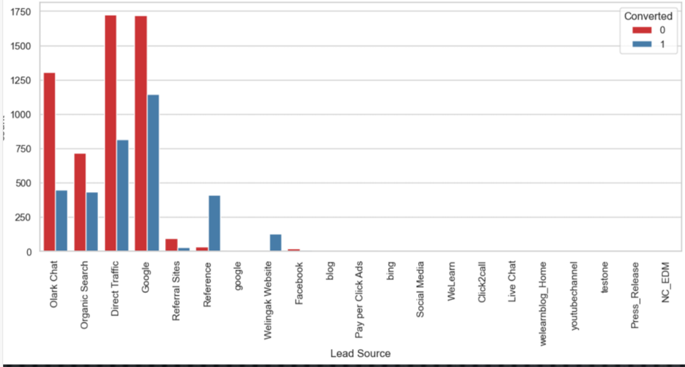
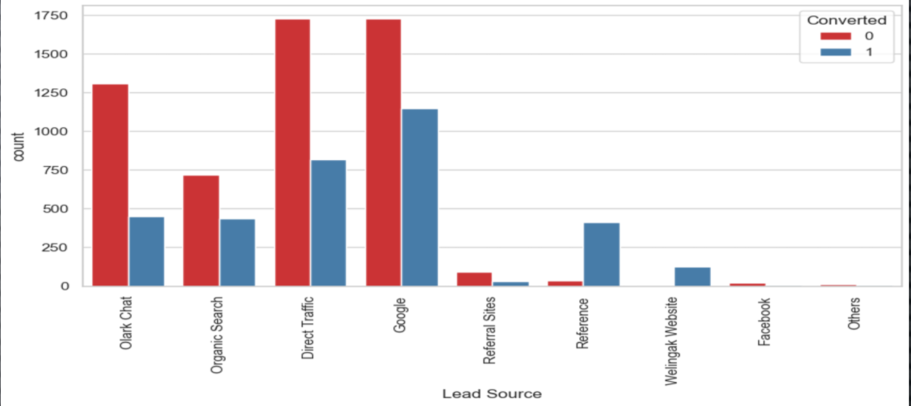
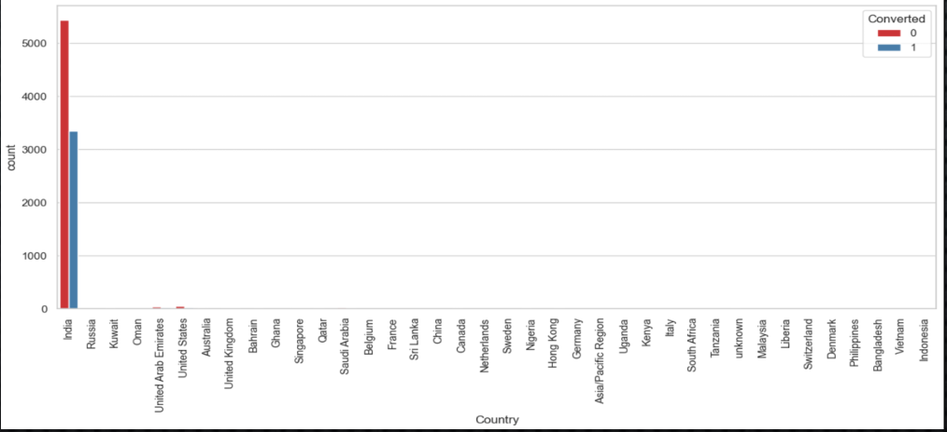
EDA-Data Cleaning

Slide 7
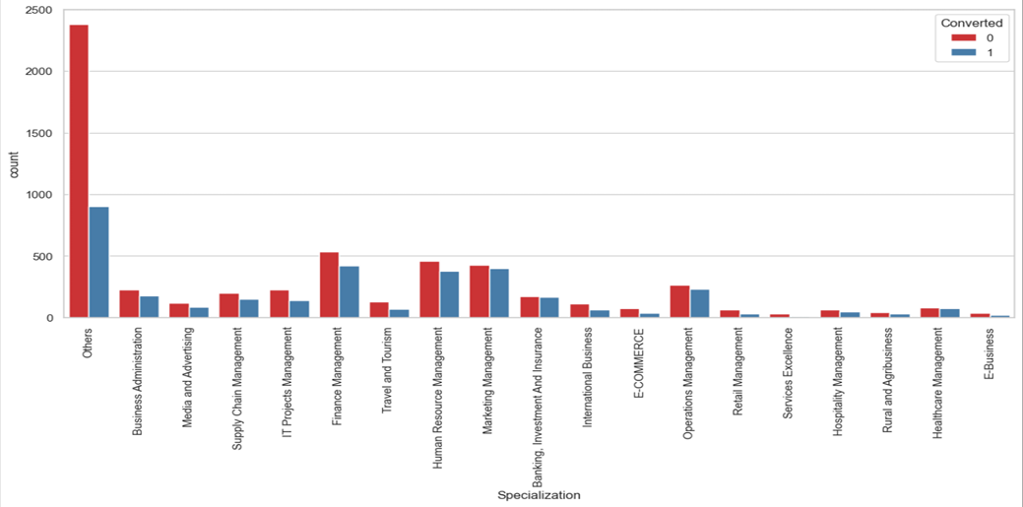
Specilization
Lead From HR, Finance And Marketing Management Specilization are High Probability
To Convert.

Slide 8
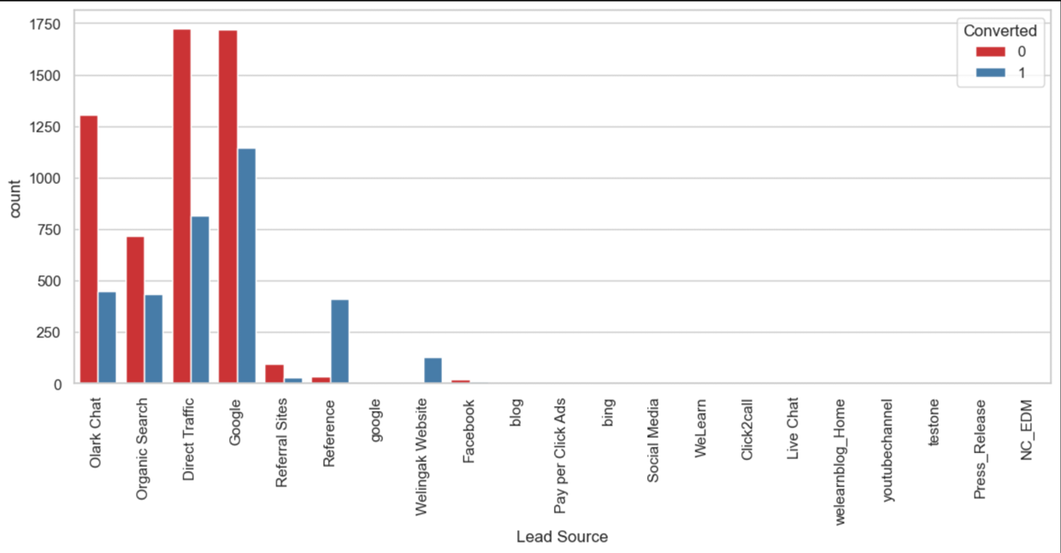
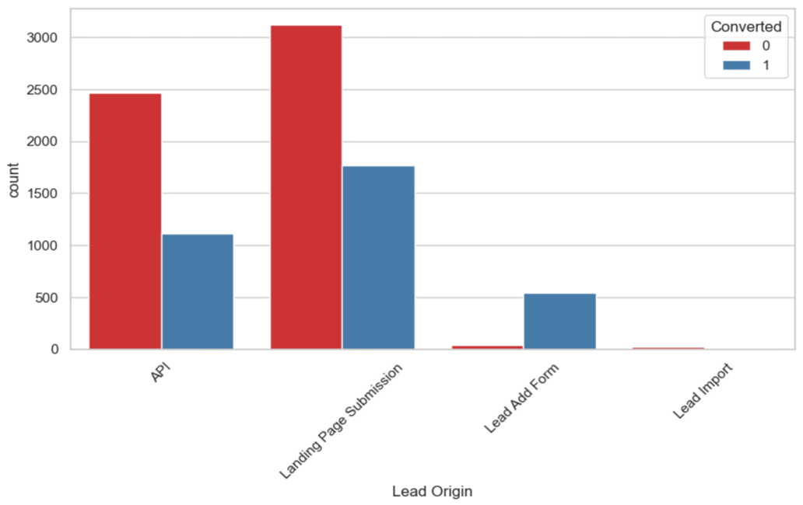
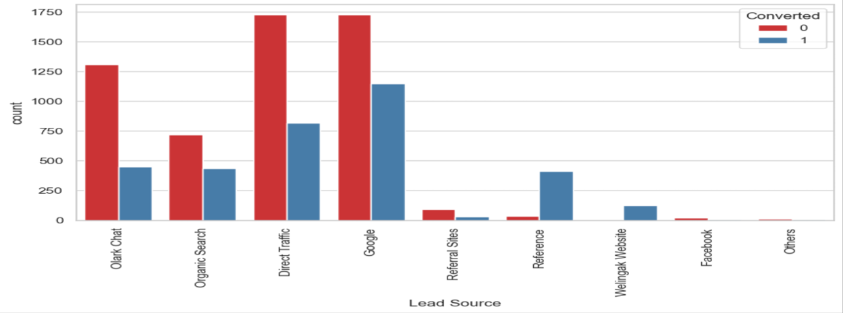
LEAD SOURCE AND LEAD
Origin in lead source the lead through Google and Direct Traffic Hhi Probability To Convert

Slide 9
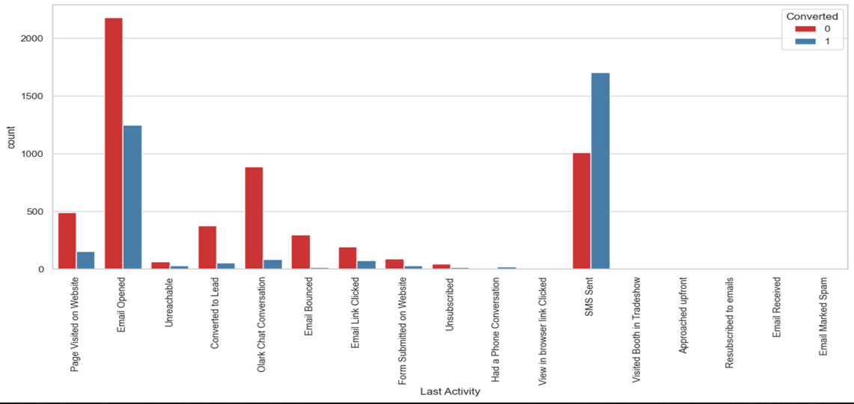
LAST LEAD ACTIVITY
LEADS WHICH ARE OPENING EMAIL HAVE HIGH PROBABILITY TO CONVERT,
SENDING SMS WILL ALSO BENEFIT

Slide 10
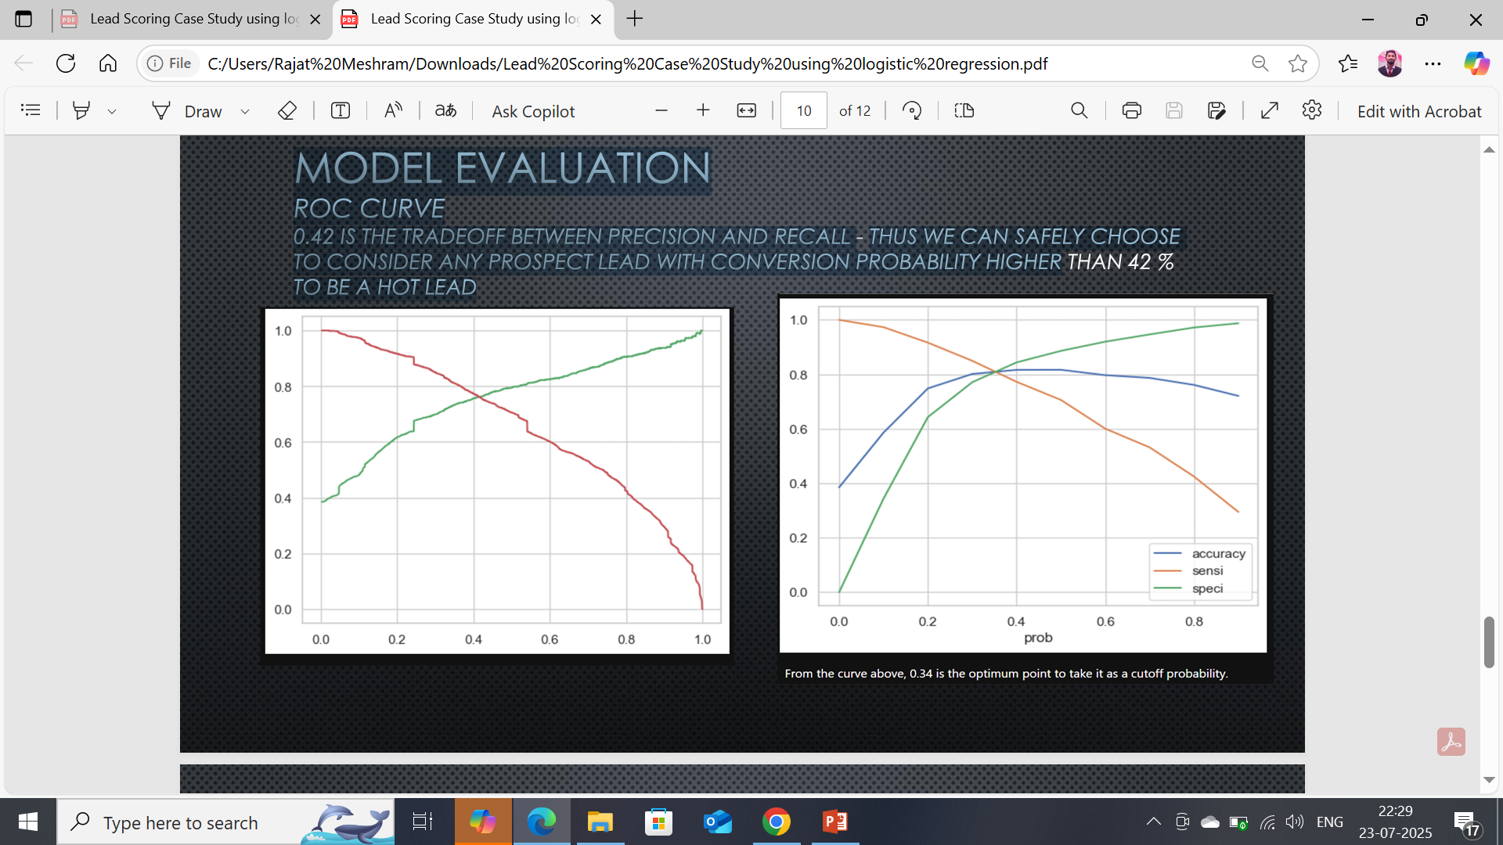
MODEL EVALUATION
ROC CURVE
0.42 IS THE TRADEOFF BETWEEN PRECISION AND RECALL THUS WE CAN TO CONSIDER ANY PROSPECT LEAD WITH CONVERSION PROBABILITY HIGHER
TO BE A HOT LEAD

Slide 11
OBSERVATIONS
TRAINDATA: ACCURACY: 80%
SENSITIVITY: 77%
SPECIFICITY: 80%
TESTDATA:
ACCURACY: 80%
SENSITIVITY: 77%
SPECIFICITY: 80%
FINALFEATURESLIST:
LEADSOURCE_OLARKCHAT
SPECIALIZATION_OTHERS
LEADORIGIN_LEADADDFORM
LEADSOURCE_WELINGAKWEBSITE
TOTALTIMESPENTONWEBSITE
LEADORIGIN_LANDINGPAGESUBMISSION
WHAT ISYOURCURRENTOCCUPATION_WORKINGPROFESSIONALS
DONOTEMAIL

Slide 12
CONCLUSION
❖WE SEE THAT THE CONVERSION RATE IS 30-35% (CLOSE TO AVERAGE) FOR API AND
LANDING PAGE SUBMISSION. BUT VERY LOW FOR LEAD ADD FORM AND LEAD IMPORT.
THEREFORE WE CAN INTERVENE THAT WE NEED TO FOCUS MORE ON THE LEADS ORIGINATED
FROM API AND LANDING PAGE SUBMISSION.
❖WE SEE MAX NUMBER OF LEADS ARE GENERATED BY GOOGLE / DIRECT TRAFFIC. MAX
CONVERSION RATIO IS BY REFERENCE AND WELINGAK WEBSITE.
❖LEADS WHO SPENT MORE TIME ON WEBSITE , MORE LIKELY TO CONVERT.
❖MOST COMMON LAST ACTIVITY IS EMAIL OPENED. HIGHEST RATE = SMS SENT. MAX ARE
UNEMPLOYED. MAX CONVERSION WITH WORKING PROFESSIONAL.

